Slide 1
research suppliers and services

Slide 2
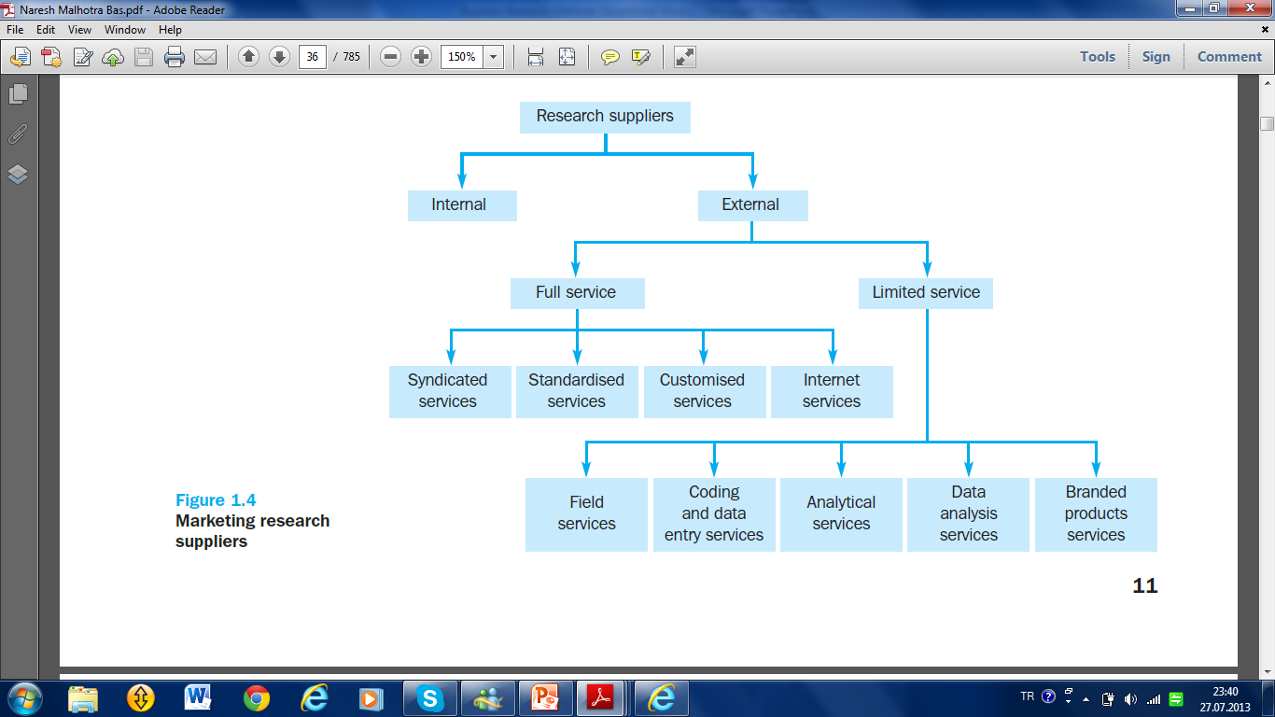

Slide 3
Internal supplier
is a marketing research department or function located within a firm. Many firms, particularly large ones, maintain in-house marketing research departments. A marketing research department’s place in an organisation structure may vary quite considerably.
At one extreme, the research function may be centralised and located at the corporate headquarters, allowing the development of a range of skills and expertise to be built up in a team.

Slide 4
At the other extreme is a decentralised structure in which the marketing research function is organised along divisional lines, allowing specific and focused expertise to be developed but without the breadth of experience that may lie in a centralised team.
In a decentralised scheme, the company may be organised into divisions by products, customers or geographical regions, with marketing research personnel assigned to the various divisions.

Slide 6
External suppliers are outside firms hired to supply marketing research data.
These external suppliers collectively comprise(kapsamak)the marketing research industry. These suppliers range from small (one or a few persons) operations to very large global corporations.

Slide 7
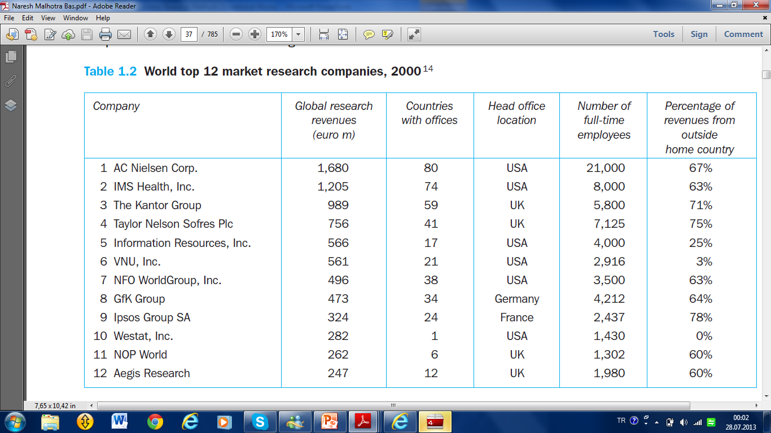

Slide 9
Full-service suppliers
offer the entire range of marketing research services, for example defining a problem, developing a research design, conducting focus group interviews, designing questionnaires, sampling, collecting, analyzing and interpreting data, and presenting reports.

Slide 10
They may also address the marketing implications of the information they present. The services provided by these suppliers can be further broken down into syndicated services, standardized services and customized services

Slide 12
Full-service suppliers
Syndicated services collect information that they provide to subscribers. Surveys, diary panels, scanners and audits are the main means by which these data are collected.
Standardised services are research studies conducted for different clients but in a standard way. For example, procedures for measuring advertising effectiveness have been standardised so that the results can be compared across studies and evaluative norms can be established.
Customised services offer a variety of marketing research services specifically designed to suit a client’s particular needs. Each marketing research project is treated uniquely.
Internet services offer a combination or variety of secondary data and intelligence gathering, survey or qualitative interviewing, and the analysis and publication of research findings, all through the Internet.

Slide 14
Limited-service suppliers specialise in one or a few phases of a marketing research project. Services offered by such suppliers are classified as field services, coding and data entry, analytical services, data analysis, and branded products.

Slide 15
Field services collect data through mail, personal interviews or telephone interviews, and firms that specialise in interviewing are called field service organisations. These organisations may range from small proprietary organisations that operate locally to large multinationals.
Coding and data entry services include editing completed questionnaires, developing a coding scheme, and transcribing the data on to diskettes or magnetic tapes for input into a computer.
Analytical services include designing and pretesting questionnaires, determining
the best means of collecting data, and designing sampling plans, as well as other
aspects of the research design.
Data analysis services are offered by firms, that specialise in computer analysis of quantitative data such as those obtained in large surveys. Initially, most data analysis firms supplied only tabulations and cross-tabulations. Now, many firms offer sophisticated data analysis using advanced statistical techniques.
Branded marketing research products and services are specialised data collection and analysis procedures developed to address specific types of marketing research problems. These procedures may be patented, given brand names, and marketed like any other branded product. Microscope by Retail Marketing (In-Store) Services is an example of a branded product.

Slide 16
Factors Influencing Company Marketing Strategy
Marketing
intermediaries
Demographic/
economic
environment
Technical/
physical
environment
Marketing
planning
system
Marketing
information
system
Product
Customer
Relationships
Suppliers
Place
Price
Publics
Marketing
organization
system
Promotion
Marketing
Implementation
system
Political/
legal
environment
Social/
cultural
environment
Competitors

Slide 17
Marketing Mix Research
Product Research
Price Research
Distribution Research
Promotion Research

Slide 18
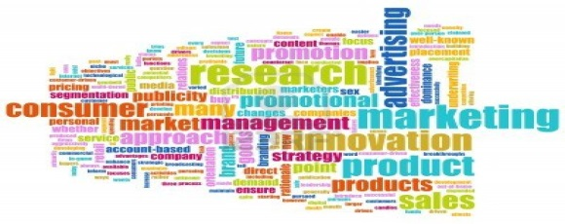
Product Research
Product research takes many forms and includes studies designed to evaluate and develop new products and to learn how to adapt existing product lines. Concept testing exposes potential customers to a new product idea to judge the acceptance and feasibility of the concept.
Brand-name evaluation studies investigate whether a name is appropriate for a product.
Package testing assesses size, color, shape, ease of use, and other attributes of a package.

Slide 19
Price Research
Many test markets address the question of how consumers will respond to a product offering two different prices. Pricing involves finding the amount of monetary sacrifice that best represents the value customers perceive in a product after considering various market constraints (kısıtlamalar).
Pricing research also investigates the way people respond to pricing tactics. How do consumers respond to price reductions in one form or another? How much are people willing to pay for some critical product attribute (nitelik)? Do consumers view prices and/ or quantity discounts as fair in a given category? Do price gaps among national brands, regional brands, and private labels exist?

Slide 20
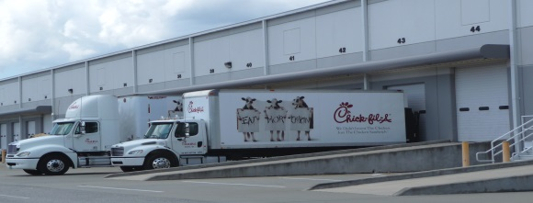
Distribution Research
Distribution research is symbolized by studies aimed at selecting retail sites or warehouse locations. A survey of retailers or wholesalers may be conducted because the actions of one channel member can greatly affect the performance of other channel members. Distribution research often is needed to gain knowledge about retailers’ and wholesalers’ operations and to learn their reactions to a manufacturer’s marketing policies.
It may also be used to examine the effect of just-in-time ordering systems or exclusive distribution on product quality. Research focused on developing and improving the efficiency of marketing channels is extremely important.

Slide 21
Promotion Research
Promotion research investigates the effectiveness of advertising, premiums, coupons, sampling, discounts, public relations, and other sales promotions. However, among all of these, firms spend more time, money, and effort on advertising research.
Media research helps businesses make decisions about whether television, newspapers, magazines, or other media alternatives are best suited to convey the intended message. Choices among media alternatives may be based on research that shows the proportion of consumers in each market segment that a particular advertising vehicle can reach

Slide 22
C) Product
10. concept development and testing
11. brand name generation and testing
12. test markets
13. product testing of existing products
14. packaging design studies
15. competitive product studies
(D) Advertising
16. copy testing
17. promotion effectiveness studies
(E) Distribution
18. plant/warehouse location studies
19. channel performance studies
20. channel coverage studies
21. export and international studies
Different Specific Research Topics
(A) Business/Economic and Corporate Research
1. industry/market characteristics /consumer profiles
2. acquisition/diversification studies
3. market-share analyses 4. internal employee studies (e.g., morale)
(B) Pricing
5. cost analysis
6. profit analysis
7. price elasticity
8. demand analysis: market potential
sales potential
sales forecasts
9. competitive pricing analyses

Slide 23
International Business Research Process

Slide 24
1. Determining research type
2. Defining problem/opportunity
First Step
Preparing stage
3. Past of the subject
4. Questioning the research
5. Planning of research proposal
Second Step
Designing
the study
6. Choosing research method
7. Selecting sampling method
8. Collecting data
9. Classifying data
10. Analyzing data
Third Step
Implementing
the study
11. findings interpretation
12. preparing report
13. Implementing the suggestions
14. monitoring the results

Slide 25
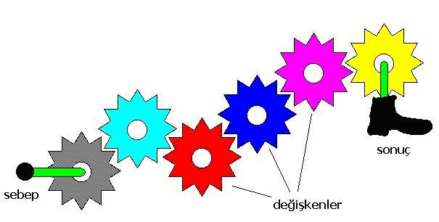
First Step Preparing stage 1. Determining research type
A. Exploratory Research
B. Descriptive Research
C. Causality Research

Slide 26
A. Exploratory Research
♦ Conducted for a problem that has not been clearly defined.
♦ It should draw definitive conclusions only with extreme caution.
♦ Perceived problem does not actually exist. Exploratory research often relies on secondary research such as reviewing available literature and/or data, or qualitative approaches such as informal discussions with consumers, employees, management or competitors, and more formal approaches through in-depth interviews, focus groups, projective methods, case studies or pilot studies.
♦ The Internet allows for research methods that are more interactive in nature. For example, RSS feeds efficiently supply researchers with up-to-date information; major search engine search results may be sent by email to researchers by services such as Google Alerts.
♦ The results of exploratory research are not usually useful for decision-making by themselves, but they can provide significant insight into a given situation.
♦ Exploratory research is not typically generalizable to the population at large.

Slide 27
B. Descriptive Research
Descriptive research, is used to describe characteristics of a population or phenomenon being studied. It does not answer questions about how/when/why the characteristics occurred.
Rather it addresses the "what" question (What are the characteristics of the population or situation being studied?) The characteristics used to describe the situation or population are usually some kind of categorical scheme also known as descriptive categories. Descriptive research generally precedes (öncesinde gelmek) explanatory research.

Slide 28
C. Causality Research
Causality (also referred to as causation) is the relation between an event (the cause) and a second event (the effect), where the second event is understood as a consequence of the first.
In common usage, causality is also the relation between a set of factors (causes) and a phenomenon (the effect). Anything that affects an effect is a factor of that effect. A direct factor is a factor that affects an effect directly, that is, without any intervening factors. (Intervening(aracı) factors are sometimes called "intermediate factors".)

Slide 29
Examples for Types of Research Designs
Uses
Types
Formulate problems more precisely
Establish priorities for research
Eliminate impractical ideas
Clarify concepts
Develop Hypotheses
Literature search
Experience survey
Analysis of select cases
Focus groups
Interviews
Projective tests
Ethnographies
Exploratory
Research
Describe segment characteristics
Estimate proportion of people who behave in a certain way
Make specific predictions
Test hypotheses
Descriptive
Research
Longitudinal study
True panel
Omnibus panel
Sample Survey
Provide evidence regarding causal relationships by means of:
Concomitant variation
Time order in which variables occur
Elimination other explanations
Causal
Research
Laboratory experiment
Field experiment

Slide 31
First Step Preparing stage 2. Defining problem/opportunity
The logical starting point in wishing to support the decision-maker is trying to understand what business problem or opportunity is being tackled (ele alınan).

Slide 32
First Step Preparing stage 3. Past of the subject
Means literature review. Who did, accepted, proved or rejected what? Searching past of the subject simplify the methodology process. Literature review can be conducted in a library or on Internet.

Slide 33
First Step Preparing stage 4. Questioning the research
Studies should bring a benefit to the company and contribute to solve a problem or evaluate an opportunity. At this stage, the research must be carried out cost-benefit analysis. If the research cost is more than the benefit comes from the research, it is not necessary to continue the research.

Slide 34
Second Step Designing the study 5. Planning research proposal
The purpose of any research should be written down. There is no ideal and single format or standard in social researches which includes all the steps of a research. Marketing research plan identifies and thoroughly explains all the steps one by one. Apart from these two issues a plan should include:
Research cost and
(2) The time table

Slide 35
(A) Problem Definition
1. background information
2. decision problem
3. evaluation of alternative research problems
4. research problem(s) to be addressed
5. review: information needed for decision
(B) Research Plan: Exploratory / Secondary Research
1. purpose
2. methods
3. results
(C) Research Plan: Descriptive Research
1. purpose
2. methods
3. sampling plan
4. data collection forms
5. data collection procedures
6. projected analyses (w/dummy tables for bivariate analyses)
7. expected results
8. limitations
(D) Timeframe
(E) Cost Estimates
Research Proposal in Details

Slide 36
Second Step Designing the study 6. Choosing research method
Elementary Data
Secondary Data
Collected by us
Collected by Somebody else

Slide 38
Second Step Designing the study 7. Selecting sampling method

Slide 39
Third Step
Implementing
the study
8. Collecting data
Data collection usually takes place early on in an improvement project, and is often formalised through a data collection plan which often contains the following activity:
1. Pre collection activity — agree on goals, target data, definitions, methods
2. Collection — data collections
3. Present Findings — usually involves some form of sorting^{[2]} analysis and/or presentation.
Other main types of collection include census, sample survey, and administrative by-product and each with their respective advantages and disadvantages. A census refers to data collection about everyone or everything in a group or statistical population and has advantages such as accuracy and detail, and disadvantages such as cost and time

Slide 40
Third Step
Implementing
the study
9. Classifying data
Data can be classify by using some statistical package programs such as SPSS, SAS, MINITAB. EXCEL also can be used for this purpose. Filtration or verification of data is also a part of data classification. Any mistake in data entering may cause a big analysis problem.

Slide 41
Third Step
Implementing
the study
10. Analyzing data
Analysis of data is a process of inspecting, cleaning, transforming, and modeling data with the goal of discovering useful information, suggesting conclusions, and supporting decision making. Data analysis has multiple facets and approaches, encompassing diverse techniques under a variety of names, in different business, science, and social science domains.
Some statistical techniques use in analyzing data:
Chi square
Regression
Correlation
Variance
Discriminant
Cluster
Conjoint
Multidimensional scaling

Slide 42
Third Step
Implementing
the study
11. findings interpretation
Interpretation of the statistical results needs a special ability. Usually the expert who conduct the statistical\ interprets the findings. The interpretation also should be in harmony and parallel with the goal of the research.

Slide 43
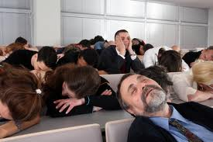
Third Step
Implementing
the study
12. preparing report
The entire project should be documented in a written report that addresses the specific research questions identified, describes the approach, research design, data collection and data analysis procedures adopted, and presents the results and major findings. Research findings should be presented in a comprehensible format so that they can be readily used in the decision making process. In addition, an oral presentation to management should be made using tables, figures and graphs to enhance clarity and impact.

Slide 44
Third Step
Implementing
the study
13. Implementing the suggestions
Actually the main process ends with the 12. phase. Phase 13. and 14. are feedbacks. Sides who are related to the research will start to implement the suggestions which offered in the final report.

Slide 45
Third Step
Implementing
the study
14. Monitoring the results
The executive managers should monitor the result of the research periodically. Otherwise the result of the research could be useless and needless.

Slide 46
The limitations of business research
1 Business research does not make decisions. The role of marketing research is not to make decisions. Rather, research replaces impressions or a total lack of knowledge with pertinent(münasip)information.
2 Business research does not guarantee success. Research, at best, can improve the probability of making a correct decision. Anyone who expects to eliminate the possibility of failure by doing research is both unrealistic and likely to be disappointed. The real value of research can be seen over a long period where increasing the percentage of good decisions should be manifested in improved bottom-line performance and in the occasional revelation that arises from research.

Slide 47
Business Research in the Twenty-First Century
Global Business Research
Communication Technologies

Slide 48
Communication Technologies
Virtually (fiilen) everyone is “connected” today. Increasingly, many people are “connected” nearly all the time. Within the lifetime of the typical undergraduate college senior, the way information is exchanged, stored, and gathered has been revolutionized completely. Today, the amount of information formally contained in an entire library can rest easily in a single personal computer.
Today, we can exchange information from nearly anywhere in the world to nearly anywhere in the world almost instantly. Internet connections are now wireless, so one doesn’t have to be tethered to a wall to access the World Wide Web. Our mobile phones and handheld data devices can be used not only to converse, but also as a means of communication that can even involve business research data.
In many cases, technology also has made it possible to store or collect data for lower costs than in the past. Electronic communications are usually less costly than regular mail—and certainly less costly than a face-to-face interview—and cost about the same amount no matter how far away a respondent is from a researcher.

Slide 49
Global Business Research
Like all business activities, business research has become increasingly global as more and more firms operate with few, if any, geographic boundaries. Some companies have extensive international research operations. Upjohn conducts research in 160 different countries. ACNielsen International, known for its television ratings, is the world’s largest research company. Two-thirds of its business comes from outside the United States.12 Starbucks can now be found in nearly every developed country on the earth
Companies that conduct business in foreign countries must understand the nature of those particular markets and judge whether they require customized business strategies. For example, although the fifteen nations of the European Union share a single formal market, research shows that Europeans do not share identical tastes for many consumer products.

Slide 50
International Business Research & Ethics
Conducting business researches according to ethical cods, which are cumulated over time and suggested by marketing reserchers.

Slide 51
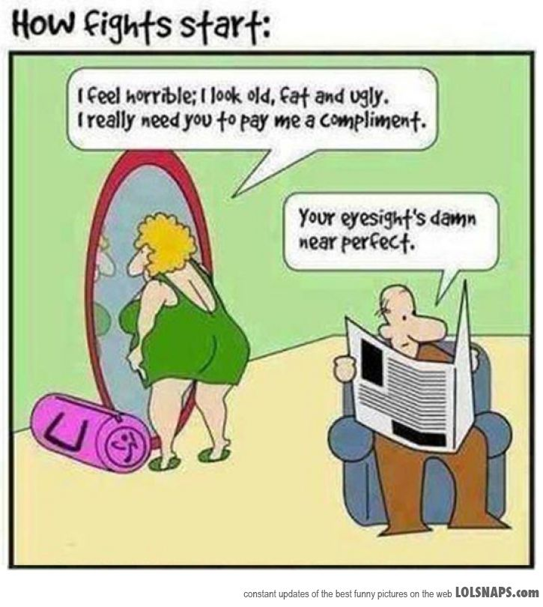
Ethical Codes in Business Researches
1. Honesty
Strive(gayret etmek)for honesty in all scientific communications. Honestly report data, results, methods and procedures, and publication status. Do not fabricate, falsify(tahrif etmek), or misrepresent data. Do not deceive(kandirmak)colleagues, granting agencies, or the public.
* Adapted from Shamoo A and Resnik D. 2009. Responsible Conduct of Research, 2nd ed. (New York: Oxford University Press).

Slide 52
Ethical Codes in Business Researches (Continue)
2. Objectivity
Strive to avoid bias in experimental design, data analysis, data interpretation, personnel decisions, expert testimony(Şahitlik), and other aspects of research where objectivity is expected or required. Avoid or minimize bias or self-deception(kandırma). Disclose(ifşa etmek) personal or financial interests that may affect research.

Slide 53
Ethical Codes in Business Researches (Continue)
3. Integrity(dürüstlük)
Keep your promises and agreements; act with sincerity; strive for consistency (tutarlılık) of thought and action.
4. Carefulness
Avoid careless errors and negligence; carefully and critically examine your own work and the work of your peers (ekip). Keep good records of research activities, such as data collection, research design, and correspondence (yazışma) with agencies or journals

Slide 54
Ethical Codes in Business Researches (Continue)
5. Openness
Share data, results, ideas, tools, resources. Be open to criticism and new ideas.
6. Respect for Intellectual Property (Fikri Mülkiyet)
Honor patents, copyrights, and other forms of intellectual property. Do not use unpublished data, methods, or results without permission. Give credit where credit is due. Give proper acknowledgement or credit for all contributions to research. Never plagiarize (intihal yapmak)

Slide 55
Ethical Codes in Business Researches (Continue)
7. Confidentiality (Gizlilik)
Protect confidential communications, such as papers or grants submitted for publication, personnel records, trade or military secrets, and patient records.
8. Responsible Publication
Publish in order to advance research and scholarship, not to advance just your own career. Avoid wasteful and duplicative publication.
9. Responsible Mentoring
Help to educate and advise students. Promote their welfare (refah) and allow them to make their own decisions.

Slide 56
Ethical Codes in Business Researches (Continue)
10. Respect for colleagues
Respect your colleagues and treat them fairly.
11. Social Responsibility
Strive to promote social good and prevent through research, public education, and advocacy.
12. Non-Discrimination
Avoid discrimination against colleagues or students on the basis of sex, race, ethnicity, or other factors that are not related to their scientific competence and integrity.

Slide 57
Ethical Codes in Business Researches (Continue)
13. Competence (Yeterlik)
Maintain and improve your own professional competence and expertise through lifelong education and learning; take steps to promote competence in science as a whole.
14. Legality
Know and obey relevant laws and institutional and governmental policies.

Slide 58
Ethical Codes in Business Researches (Continue)
15. Animal Care
Show proper respect and care for animals when using them in research. Do not conduct unnecessary or poorly designed animal experiments.
16. Human Subjects Protection
When conducting research on human subjects, minimize harms and risks and maximize benefits; respect human dignity (haysiyet), privacy, and autonomy; and strive to distribute the benefits of research fairly (dürüstçe).

Slide 59
Reasons for Conducting Ethical Researches
1. Unethical research is morally wrong: Unethical research may not be illegal, but at least it is not the right thing to do.
2. Unethical research can affect the image of the firm and management.
3. Unethical research can lead to poor-quality data and, ultimately to poor decision
4. New, potentially damaging ethical challenges are being created because of the explosive growth of technological capabilities in the research arena.

